Slide 1
Neil Harbisson - pirmas kiborgas pasaulyje
Muzika ir matematika, 2016 Marija Trapkeivič

Slide 2
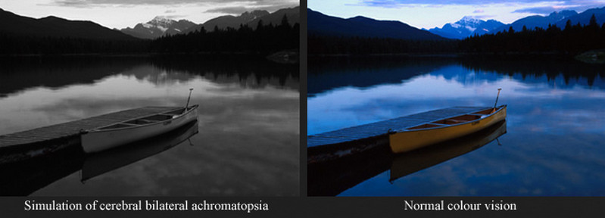
Achromatopsija

Slide 3
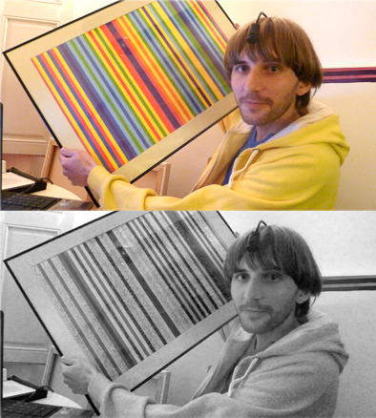
Neil Harbisson: “I am technology”

Slide 4
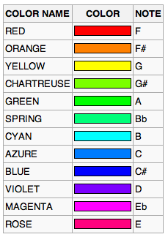
Kaip kiborgai klauso spalvų?

Slide 5
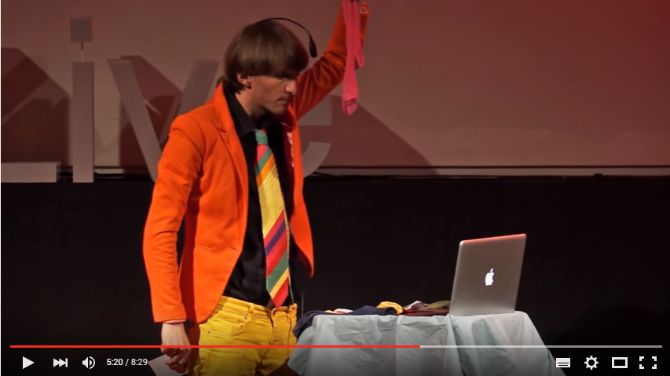
Socks Sonata Nr.1

Slide 6
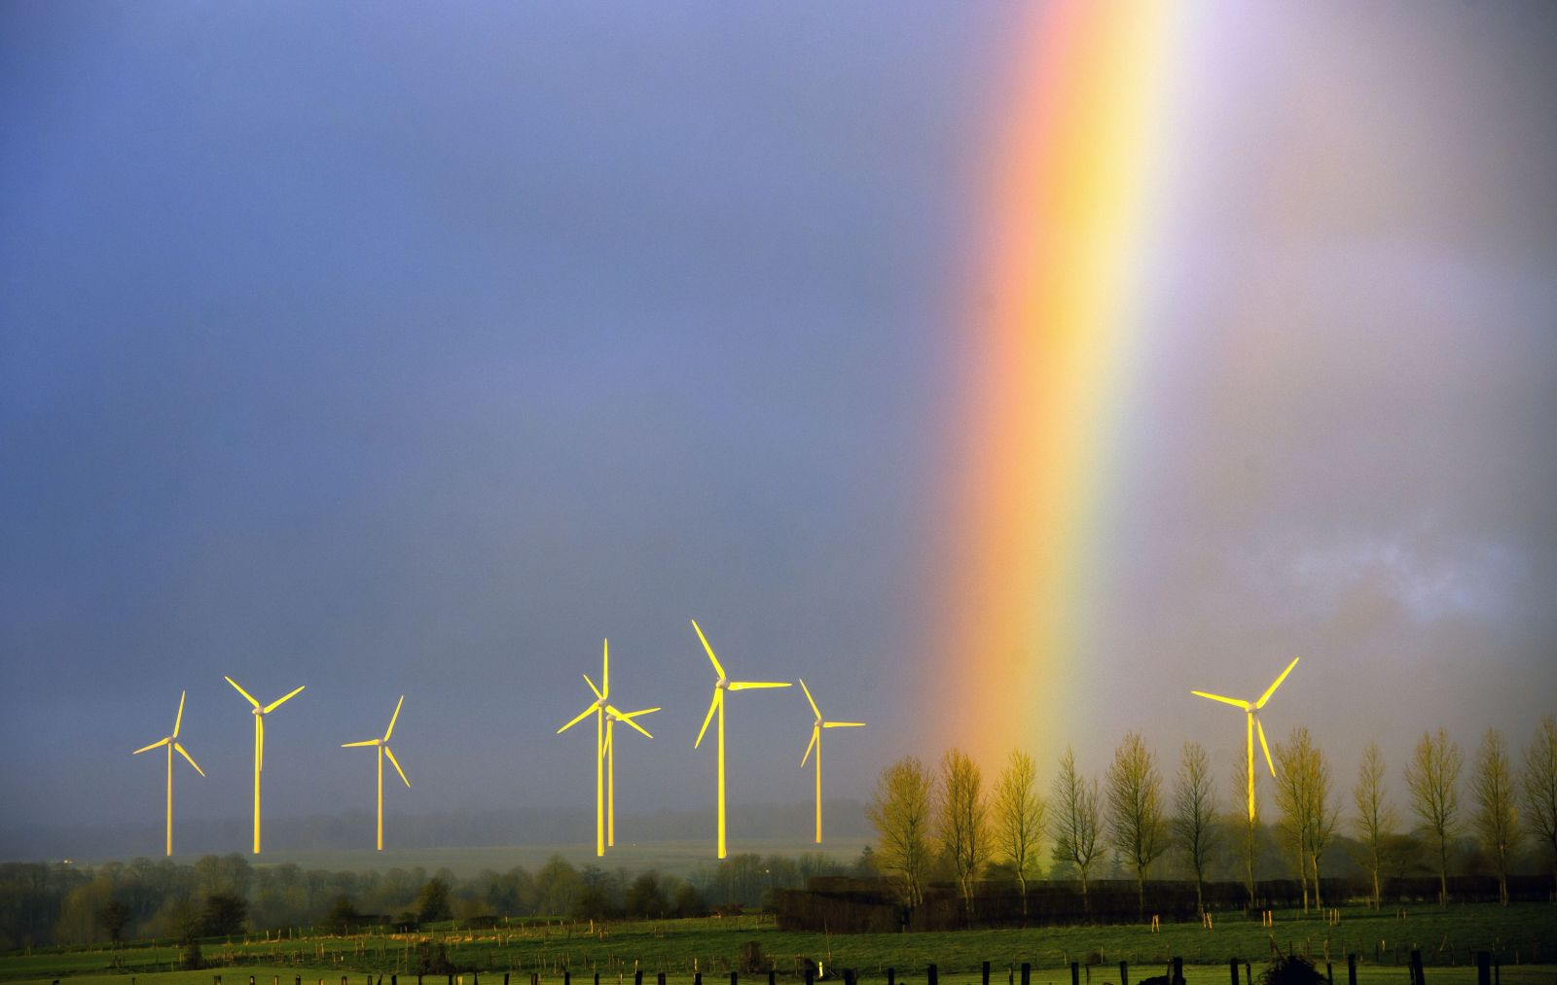
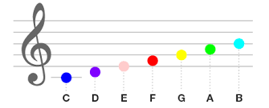
Kaip skamba vaivorykštė?

Slide 7
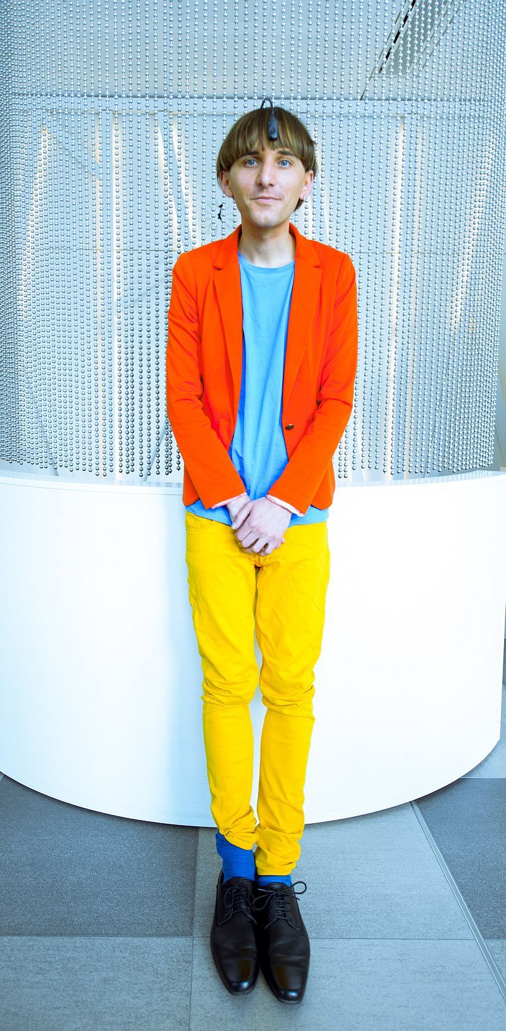
Maloniai skamba = gražiai atrodo ?
Neil: “I changed my way of dressing: before i used to dress up when it looks good, now i dress up when it sounds good”.

Slide 8
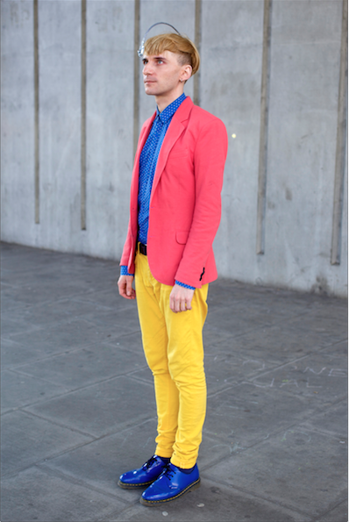
Koks akordas?
C maj

Slide 9
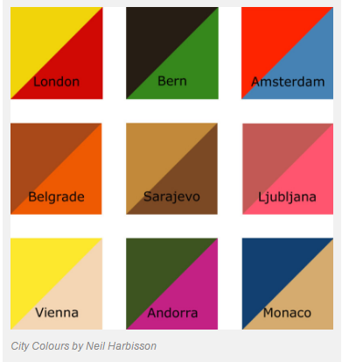
City color
Neil: “I’ve only done cities because when I grew up people told me that their city was gray. Every time I asked “What colour is London?” or “What colour is Paris?”

Slide 10
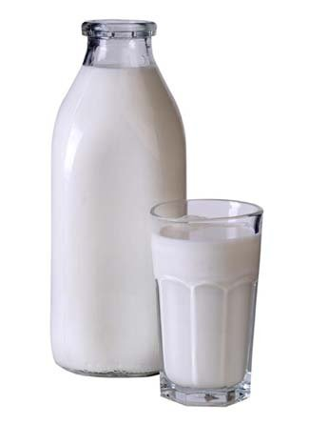
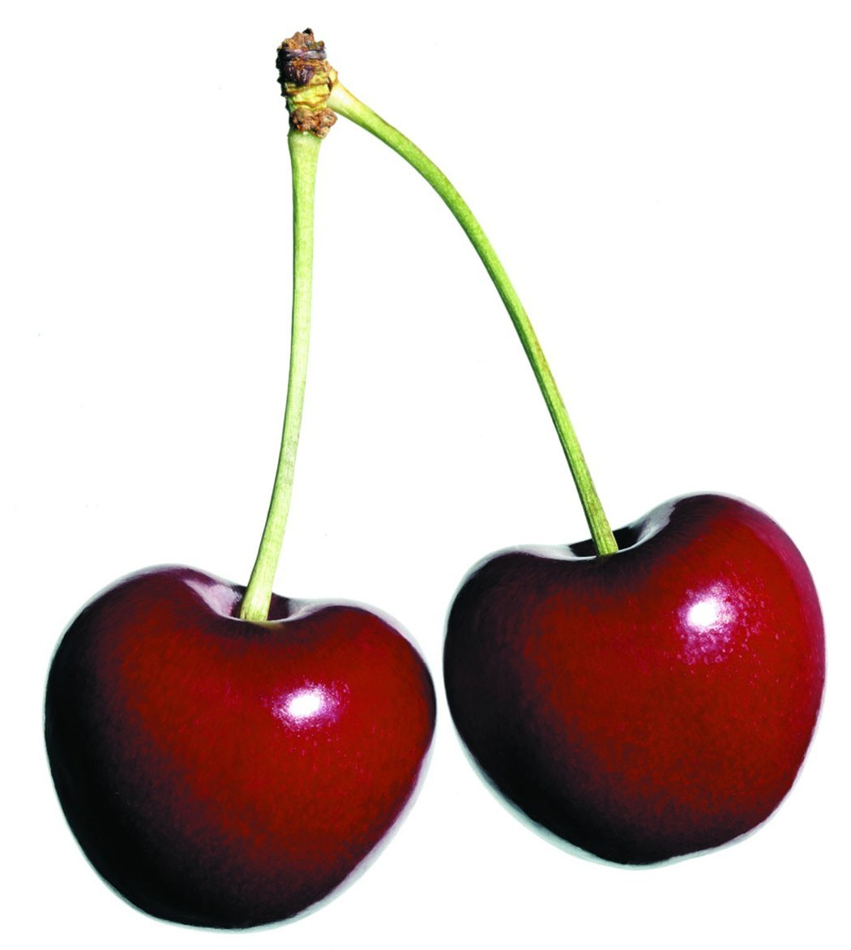
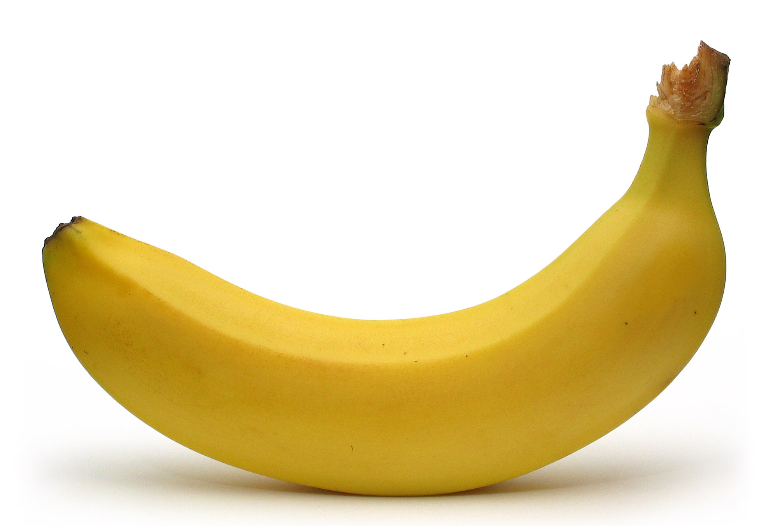
Tyla F G

Slide 11
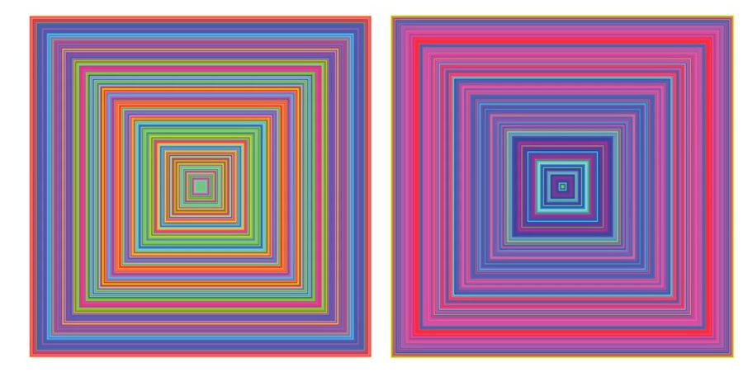

Slide 12
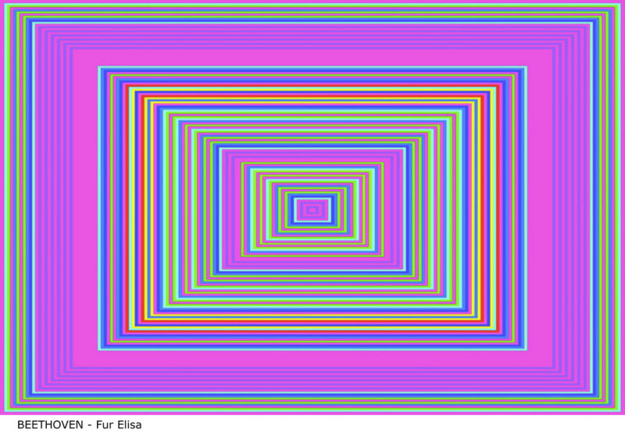
Beethoven - Fur Elisa

Slide 13
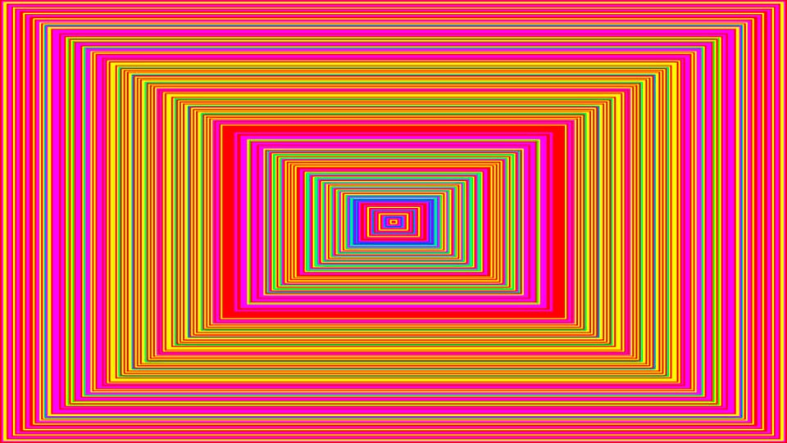
KOKIA DAINA?

Slide 14
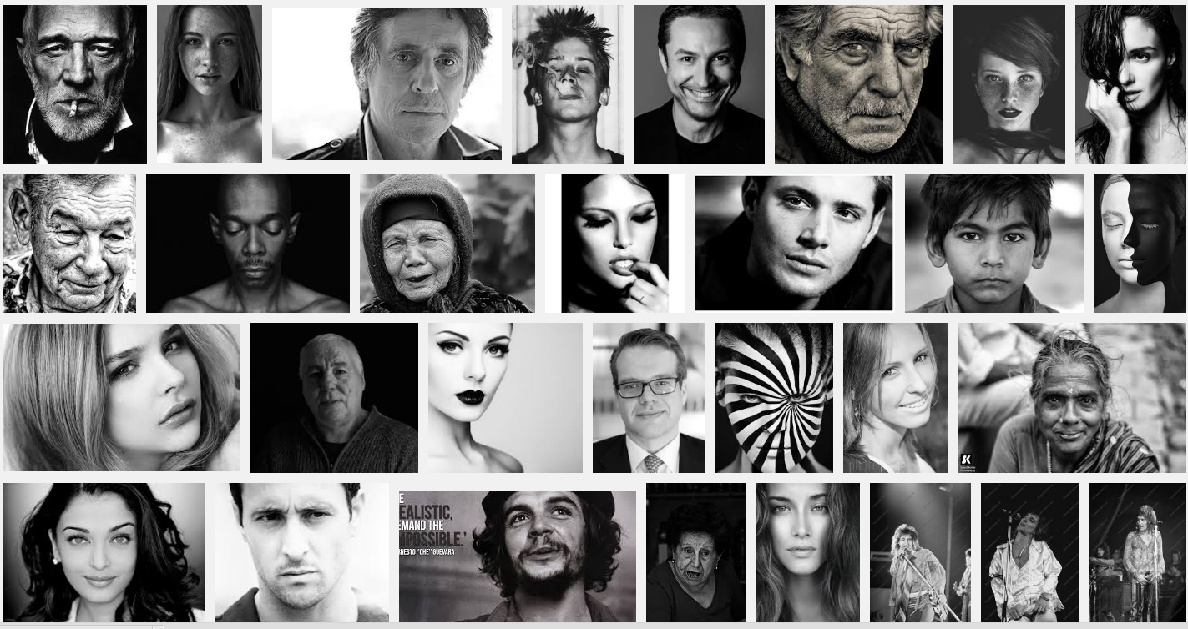
VEIDAI

Slide 15
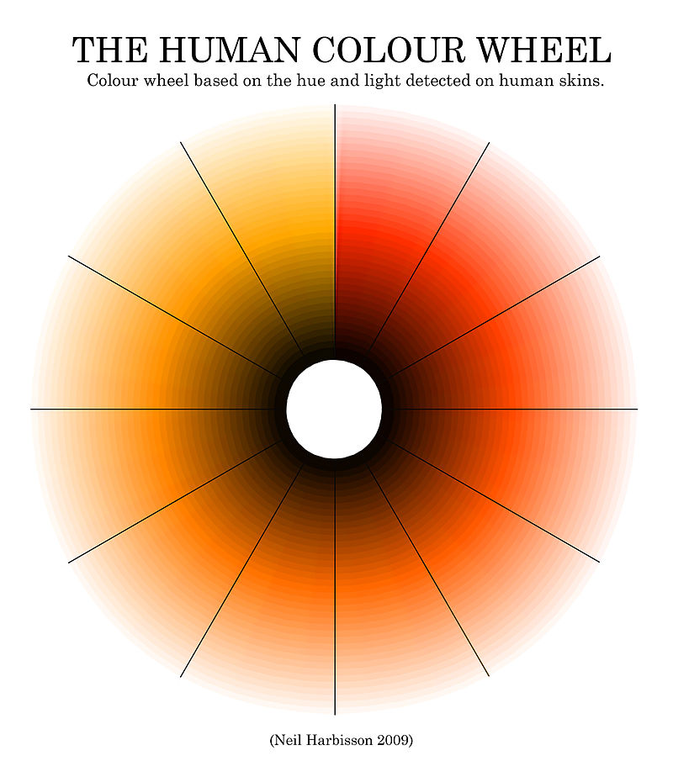
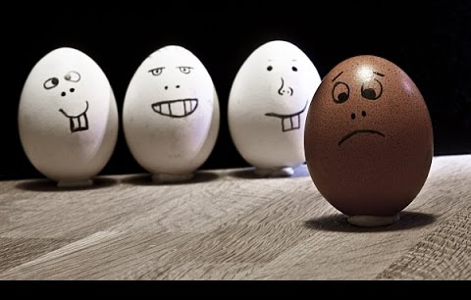
baltas - juodas

Slide 16
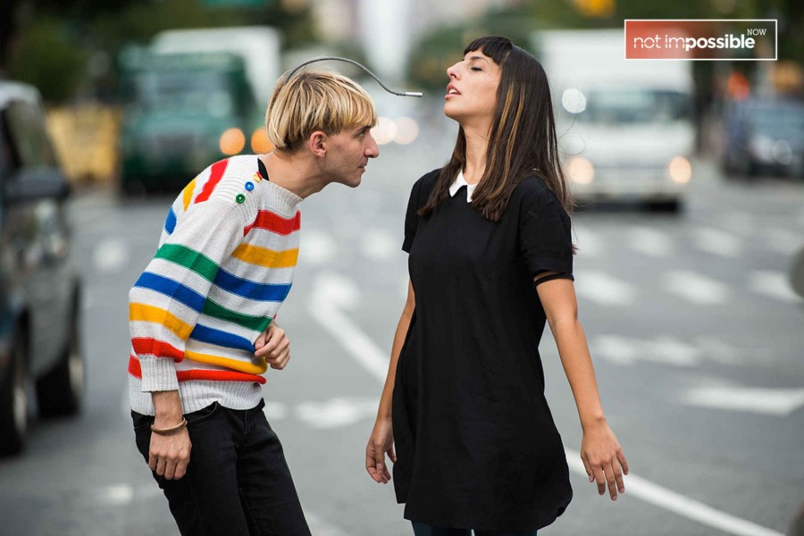
Cyborgism - art movement, where artist express theirselves through new sences which did not exist before.
Neil: “When i started to feel no difference between brain and software - then i started to feel cyborg”.

Slide 17
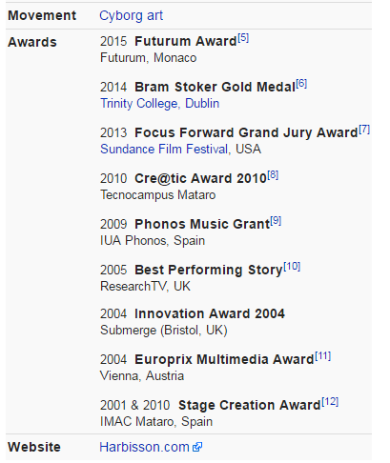
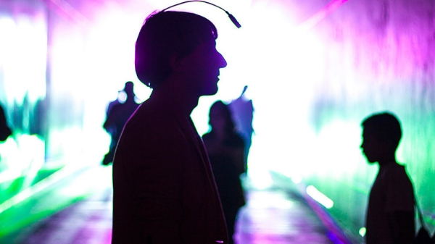

Slide 18
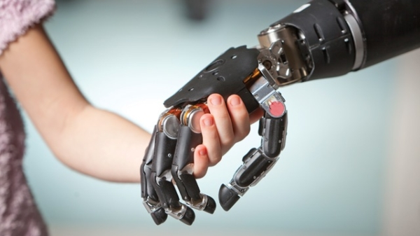
Kiborgizmo ateitis?

Slide 19
forma tembras
spalva aukštumas

Slide 20
Gal nori tapti kiborgu?

